Slide 1

π
Rag
April 2025
π

Slide 2
π
Tokenization
tokenization is a process of breaking down text into a manageable unit called token
Tokenizer divides text into word ,sub word and character
Token are typically a numeric number
Once tokenizer has been done it construct an array that is called vector
[ 245567,28897,55566,76890,5534467,556688 ]
Might be we remember
LLM charge to us on basis of token .so token play very important role for pricing calculation for company Antropic,Openai,Google,xAI

Slide 3
π
1- What is generation
Generation means Large Language Models (LLMs) that generate text in response to a user's query.
But these models have some problematic behavior.
Suppose a user asked LLM to give him news of three days ago. What will it do? It will confidently answer that according to the data It got in training, this is the news of date x. But this answer will be wrong. You will see that if you have asked for today's news, then it will give you news of 1 month ago or 1 year old news. It will have no relevance. But LLM is confident that this answer is correct, it is not wrong.
Now what happens if we add a retrieval augmented part?
This means that now the model will not run only on its training data. We add a content store. It can be open like the internet or closed like a collection of documents, policies and many other things. Now LLM first tells the content store hey give me information related to the user's question and when that information is found then what the model does. Now it can give the correct answer

Slide 4
π
2- Retrieval
how rag works, the user prompt their question to the model, if it was just a generative model then it would give the answer immediately but if
it is in RAG framework then the model first gets the instruction.
First retrieve the relevant content then combine that content with the question and then generate the answer. So now there are three parts of RAG. First is the instruction, second is the retrieved content, third is the user's question.
Instruction means what the model has to pay attention to. Second retrieve content which is the data retrieved. Third thing is the user's question which needs an answer.
Now how does rag help in this? Now how does Rag work? Firstly creating external data. LLM is limited only to its training data. If we need new and updated information then we have to create external data which is outside the original training of the model. Where can this data come from? It can come from API. That is, for example, there is weather, news feeds. From there, data can come from databases, that is, documents like student records, documents like PDFs, word files, structured or unstructured formats like CSV or plain text. If the data is too much, like a large data set, then it is broken into chunks. Then each chunk is converted into numeric format, that is, vectors, through embedding models. So that AI can understand, these vectors are stored in vector databases like Pinecone, etc. This database becomes a kind of knowledge library from which AI can take reference. The second is to retrieve relevant information. When a user writes a query, the system converts that query into a vector as well. Then this query vector is matched with the stored vector of the vector database. The most similar and relevant information is retrieved.
For example, if a user asks “What are the key topics in the DSA course?”, what will the system do? It will retrieve relevant documents like course syllabus, study material and notes. So in this case the answer given by the model is absolutely relevant and according to the user’s requirement.

Slide 5
π
3- The third thing is to augment the prompt.
That is, augmenting the LLM prompt. The relevant data retrieved is added to the prompt. This process is called prompt engineering in which we explain to the LLM in which context it has to respond. The model gives more accurate and innovative answers. That is, what happens in this is that the risk of confusion is reduced and the user gets a personalized and context-aware response.

Slide 6
π
4- Fourth is keeping external data up to date
Accurate and up to date responses are possible only when external data is refreshed regularly.
There are two ways to do this.
First is real time updates. Like pulling data from live IAPs.
Second is scheduled batch updates. Like updating the database once every morning.
Also new embedding have to be created whenever the data changes. This ensures that the Rag system always works with fresh and latest information.

Slide 7
π
Limitations of Prompt Engineering
What is Prompt Engineering:
Prompt engineering involves crafting specific input instructions or prompts to guide the output generation of AI models.
Limitations of Prompt Engineering:
Token Limitation
Hard to give detailed instructions in a small space.
AI might misunderstand or make things too simple, creating wrong or unhelpful stuff.
Knowledge Cut-off
At Risk from Tricky Inputs
Mean prompts can fool the AI into making bad or biased stuff.
We need strong ways to stop and fix these sneaky attacks.

Slide 8
π
Retrieval Augmented Generation
What is RAG ?
High Level Design
Step by Step Approach
What Problems RAG can resolve
π

Slide 9
π
RAG – What is RAG?
It's a technique that improves the accuracy and reliability of large language models (LLMs) by allowing them to access and leverage information from external knowledge sources.

Slide 10
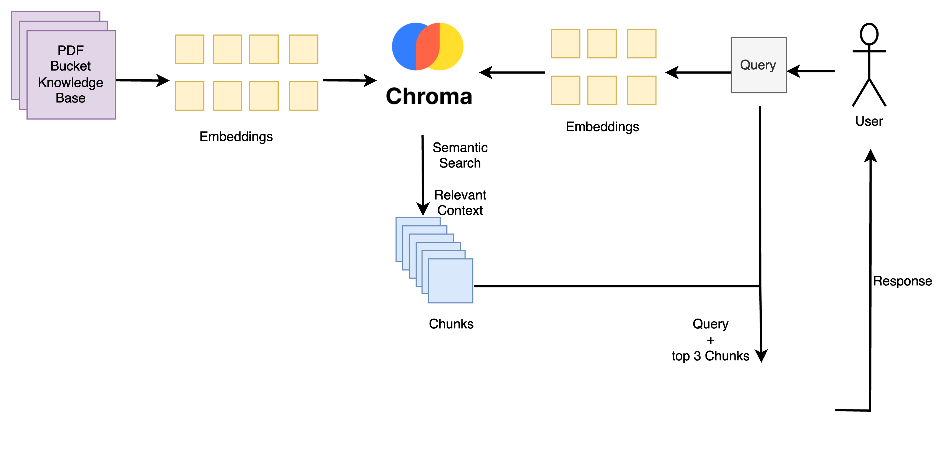
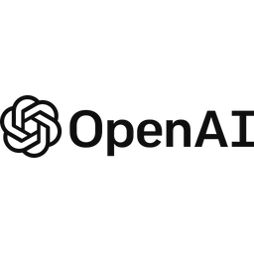
π
RAG – High Level Design

Slide 11
π
RAG – What problems RAG can Resolve?
Prompt Token Limitation
Knowledge Cut off limitation
Cost
Accuracy

Slide 12
π
Accuracy
The first problem is wrong or artificial answers,
i.e. factual inaccuracy and hallucinations. Traditional generative models sometimes give answers that seem correct but are actually wrong. That is, hallucinations occur.
What does Rag do? It helps the model to give fact-based and grounded answers by retrieving data from verified external sources.
Knowledge Cut off limitation
Now the second problem is that old or outdated information
i.e. the training data of LLMS has a knowledge cut off date. It does not get new facts or updates. Rag works as the biggest solution. By retrieving real time or updated external data, it always provides the latest information without retraining the model.

Slide 13
π
Third, the lack of contextual relevance
means that in long or contextual conversations, generative models mix up context. What does Rag do, especially in multi turn chats? Now it fetches relevant documents that enrich the context of the conversation. This makes the response more connected and relevant.
The fourth point it solves is the lack of domain specific knowledge.
Generic models cannot give accurate answers for every industry or specialized field such as medical, law, finance etc. RAG works as a solution for this. It helps in giving tailored and expert level answers by fetching relevant information from external domain specific knowledge base.
What is the fifth problem? It solves the high cost of retraining.
Fine-tuning large models for every new task is expensive and resource heavy. What does RAG do? Rag fetches external data and gives answers without retraining. This saves both cost and computation.

Slide 14
π
The sixth problem it solves is that it can be easily used in multiple domains,
that is scalability. If we have to use LLMs in health care, education, legal, finance, etc. then retraining becomes a problem. Now RAG has the advantage that the same model can be used in multiple domains by attaching different knowledge bases. It is easily scalable. Simply RAG makes LLMs smarter, updated, factual and domain specific without retraining.

Slide 15
π
RAG does not have only benefits. It also has some challenges. The first of which is complexity. The model that is formed by combining both retrieval and generation becomes very complex. This requires careful tuning and optimization so that both parts work well together.
Now the second challenge is latency. That is, when the model retrieves the data, it takes some time. Due to this, it can be difficult to run the RAG model in real time applications
Third is the quality of the retriever, that is, the performance of the RAG model depends completely on the information retrieved. If wrong or useless documents are found, then the answer can also be useless.
Fourth is bias and fairness. That is, like other AI models, RAG can also pick up bias from the training data or retrieved documents. Therefore, regular monitoring is necessary to reduce bias.

Slide 16
π
RAG – Step by Step Approach
Chunking
Embedding
Vector DB
Semantic Search
Generative Search

Slide 17
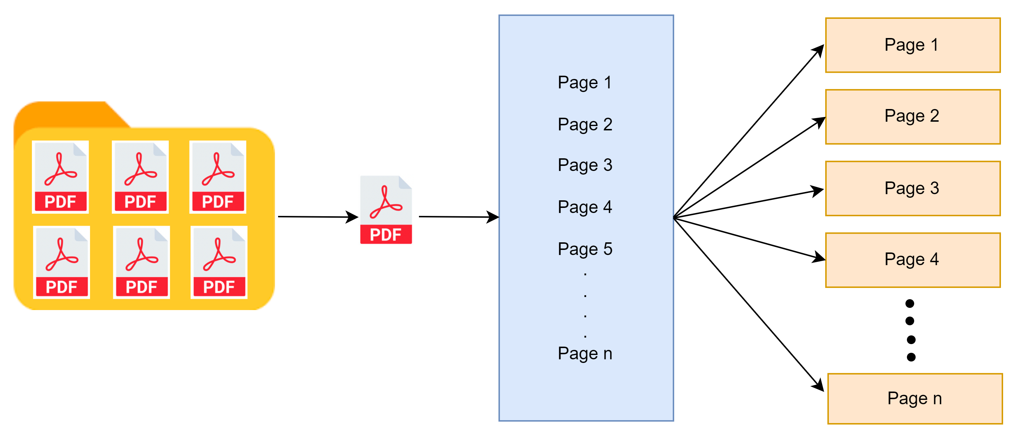
π
Chunking:
Reference: https://www.pinecone.io/learn/chunking-strategies/
Notes:
Modify this diagram

Slide 18
π
Chunking:
In the context of information processing, chunking refers to the practice of dividing larger pieces of data, text, or information into smaller, manageable units, or "chunks
Chunking strategy for data are:
Fixed-Length Chunking
Sentence or Paragraph Chunking
Page Chunking
Notes:
Modify this diagram

Slide 19


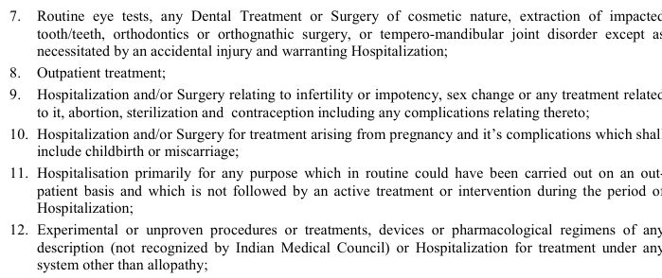
π
Fixed-Length Chunking
Notes:
Modify this diagram

Slide 20
π
Fixed-Length Chunking
Description: Splits text into chunks of a predetermined number of words, characters, or bytes.
Example Use Case: Analyzing social media posts for sentiment analysis.
Advantages: Simplicity and uniformity in chunk size.
Disadvantages: Potential context loss, as chunks may end mid-sentence or mid-thought.
Notes:
Content: https://www.linkedin.com/pulse/chunking-strategies-ai-data-kash-kashyap-0lghe/
Code: https://medium.com/@thallyscostalat/chunking-strategies-optimization-for-retrieval-augmented-generation-rag-in-the-context-of-e47cc949931d

Slide 21

π
Example: Sentence Chunking:
Notes:
Modify this diagram

Slide 22
π
Sentence or Paragraph Chunking
Description: Breaks text into chunks based on natural language structures like sentences or paragraphs.
Example Use Case: Document summarization or content analysis tasks, such as processing news articles or academic papers.
Advantages: Maintains linguistic integrity, keeping sentences and paragraphs intact.
Disadvantages: variable chunk sizes which can be challenging to manage in some models.
Notes:
Content: https://www.linkedin.com/pulse/chunking-strategies-ai-data-kash-kashyap-0lghe/

Slide 23

π
Example: Page-based Chunking:
Notes:
Modify this diagram

Slide 24
π
Page-based Chunking
Description: Dividing a PDF document into distinct pages to facilitate focused text processing and analysis at the page level.
Example Use Case: Complex tasks like document The summaries can then be combined to provide an overview of the entire document, making it easier for users to grasp the main points without having to read the entire content in detail.
Advantages: By using this strategy we can enable parallel processing of individual pages.
Disadvantages: In this strategy we may Loss Cross-Page relationship and another major disadvantage is Potential Context Disruption
Notes:
Content: https://www.linkedin.com/pulse/chunking-strategies-ai-data-kash-kashyap-0lghe/

